Slide 1
Final Project Presentation (Washing Machine/Drier)
Presentor: Teja Tiriveedhi

Slide 2
Project Description
JT Industries has been assigned to build a washing machine that works on a FPGA board. The washing machine would have different washing options suitable for different clothes and temperatures.
Requirements for this washing machine are presented on the next slide

Slide 3
Requirements
The washing machine shall have three different washing modes
: Delicates
: Normal
: Power Wash
Switches will be used to set the different modes. Users can only select one mode, once the mode is chosen, the mode cannot be changed when the wash cycle is running. The machine can’t be turned off in the middle or reset.
: SW 1 shall set to delicates
:SW 2 shall set to Normal
:SW 3 shall set to Power Wash

Slide 4
Requirements (Continued)
3) Users shall also have the option to choose the temperatures. The temperatures will be set based on the amount inputted.
: 1.0 Dollar shall set to cold temperature
: 2.0 Dollar shall set to high temperature
: BTNU shall enter the amount to one dollar
: BTND shall enter the amount to two dollars
: The time shall be set only and wash cycle starts only when the respective switches are high and the amount is entered.

Slide 5
Requirements (Continued)
4) The washing modes shall be divided into the following wash cycles with the following times
: Delicates : 36 minutes ,with the following divisions, Wash:7 min, Rinse: 11 min, Spin: 18 min
: Normal: 40 minutes, with the following divisions. Wash:11 min, Rinse: 11 min, Spin:18 min
: Power wash: 45 minutes, with the following divisions Wash:16 min, Rinse: 11 min, Spin: 18 min
Switches will be used to set the time. For example, SW 1 is being used to set the mode to delicates so SW 1 would set the washing machine time to 36 minutes.

Slide 6
Requirements(Continued)
LED’s shall turn on after each stage in washing cycle is completed.
LED[1] turns on after wash is completed
LED[2] turns on after rinse is completed
LED[3] turns on after the spin is completed which means the whole wash cycle is completed
Users shall see the completion of each stage when the SW inputted for the mode is high only.

Slide 7
Requirements (Continued)
6) AN[5] shall display the amount entered. AN[6] and AN[7] would display the washing machine cycle time.
7) Once all the washing cycles are completed, AN[5](dollar amount) would reset to zero and it would never set the timer again as per the washing machine mode.

Slide 8
Requirements (Continued)
: SW 4 shall set to drier mode. Drier time is 60 minutes. LED[0] would turn on to indicate the start of the drier and LED[1] would turn on to indicate the end of the drier.
Users shall see the start and end cycle of the drier when the SW inputted for the mode is high only.
Drier would operate only on high temperature

Slide 9
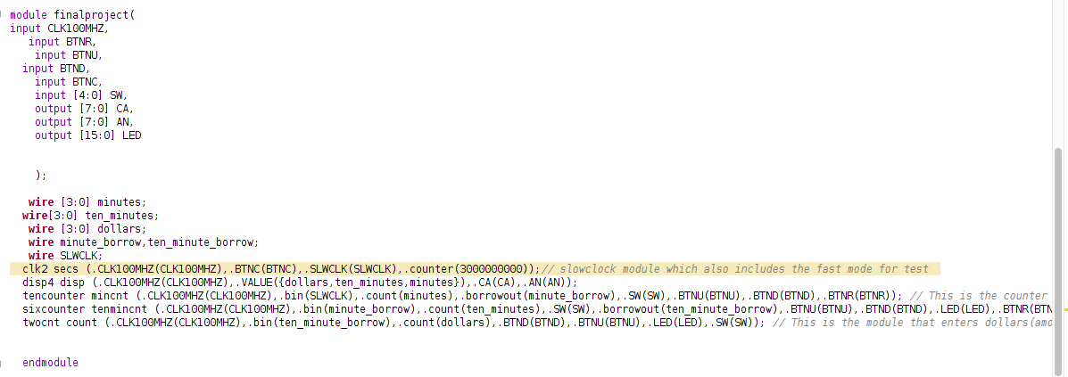
Approach

Slide 10
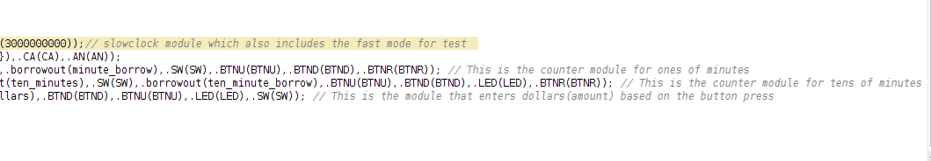

Slide 11
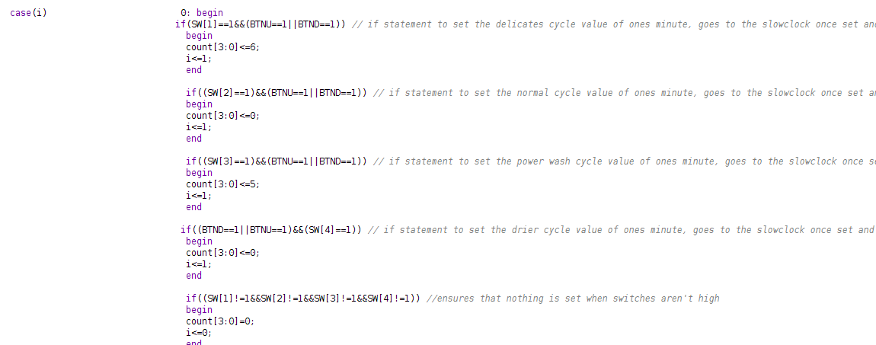

Slide 12
Challenges and problems
: Getting the state machine to work, it took time to figure out how to make the switches to set the time according to the washing mode. For example, SW 1 should set to 36 minutes and display on the seven segment, I had tough time in figuring out how to display 36 minutes and start the count down only when SW 1 is pressed.
: Figuring out how to make the decrement by having a borrow out.
: Getting LED’s turning on at the correct instances

Slide 13
Lessons Learned
: Got more practice with logic and state machines(case statements). Didn’t want multiple input sources working at a time.
: Got more practice working with the clock
: Project is on the similar lines of Lab 4,5 and 8.

Slide 14
Test Cases/Demo
Requirement | Test Case | Result
Setting of different modes using different switches to the correct time | SW 1 sets to 36 minutes. SW 2 to 40 minutes SW 3 to 45 minutes SW 4 to 60 minutes | Correct time is set. Setting happens only when the amount is also inserted.
Countdown occurs in decimal for every mode | No hex value is displayed on the seven segment display for any mode | Pass

Slide 15
Test cases/demo
Requirement | Test Case | Result
Can’t change the mode or can’t turn it off | When switches are being modified the values of seven segment display should still decrement | When switches are being modified, the countdown still occurs however, LED’s don’t display the washing machine cycle completion.
LED’s turn on correctly | LED’s turn on when the switch inputs are high after each washing stage is complete. LED 1 turns on for all the modes to indicate that wash cycle is complete | Pass

Slide 16
Test cases/demo
LED’s turn on correctly | LED 2 turns on for all the modes to indicate that rinse cycle is complete LED 3 turns on when the dollar amount is reset to zero to indicate the whole cycle including the spin is complete LED 0 turns on once the drier mode has begun and LED 4 turns on once the drier mode is completed. | Pass, however they are times when the LED’s are on when the SW input is low.
Dollar amount resets successfully | AN[5] should display 0. It should also be able to go from 2 to 0. | Pass,Does reset, however one minute hand keeps decrementing
Drier operates only on high temperature | Timer only sets up when BTND and SW[4] is high | Pass,

Slide 17
Further additions/future development
Make it so that user can add cents,dimes and nickels coins
Add a Buzzer

Slide 18
Thanks for listening

